Slide 1

Team Farthorl
Databases Advanced 2016

Slide 2






Team Members
github.com/FarthorlTeamNew

Slide 3
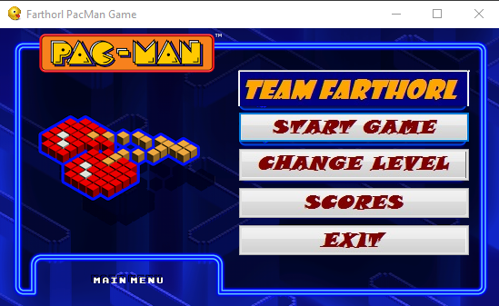
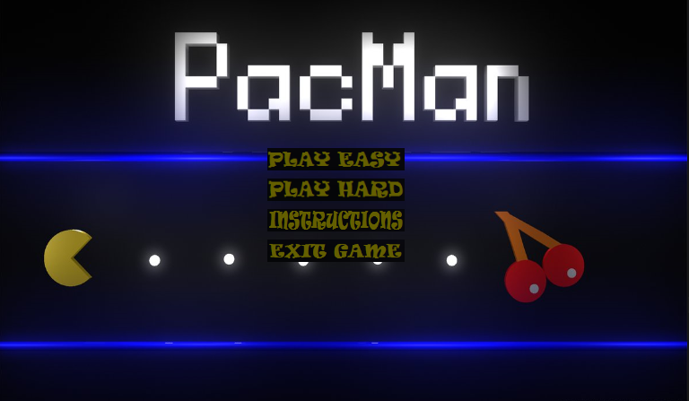
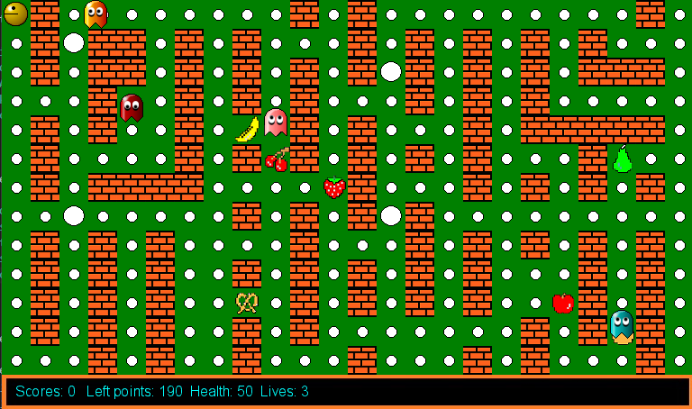
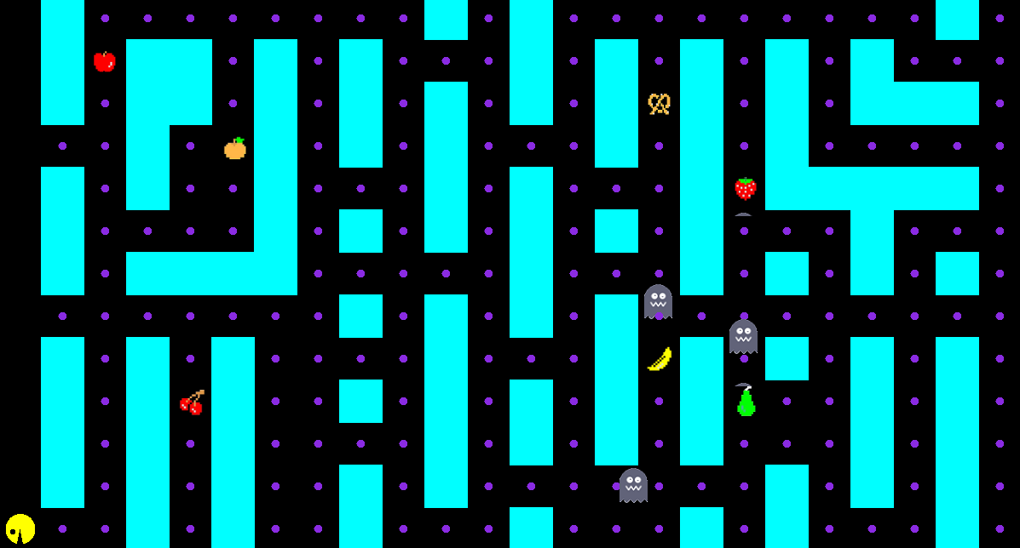
v. 0.0003
v. 0.01

Slide 4
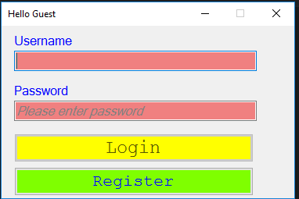
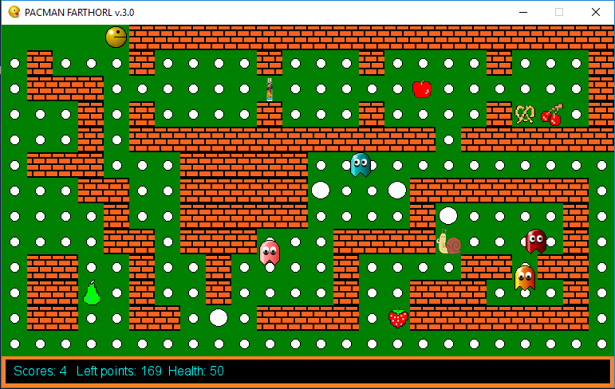
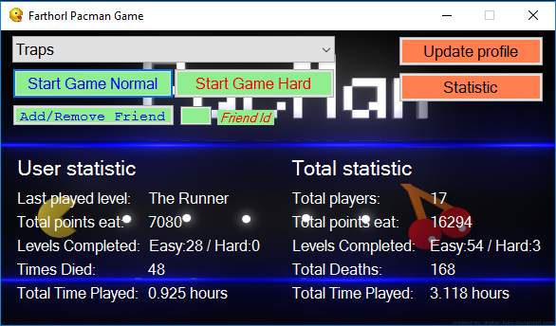
v. 0.05b

Slide 5
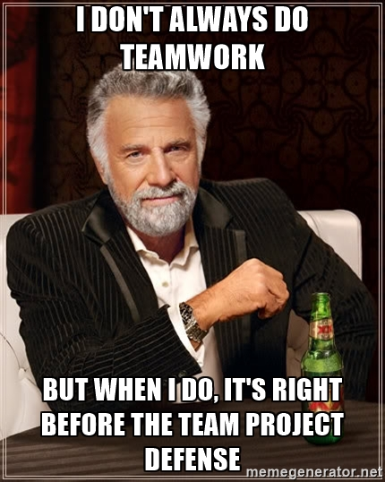
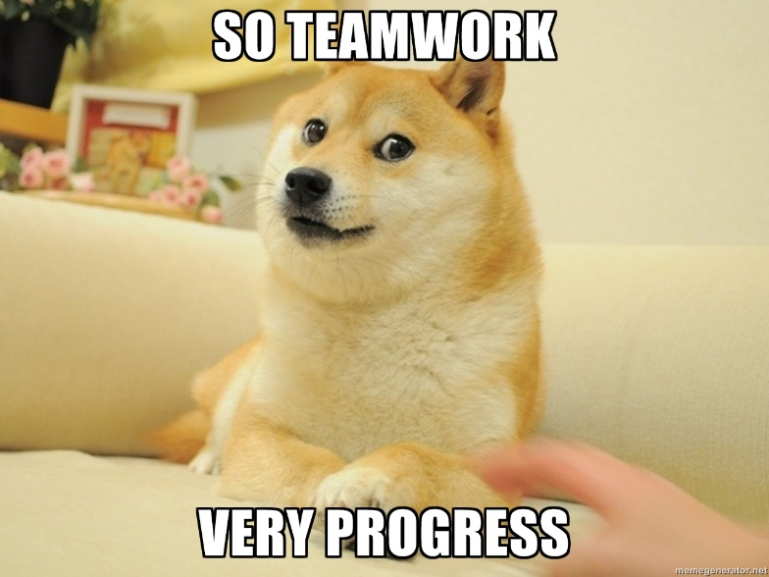
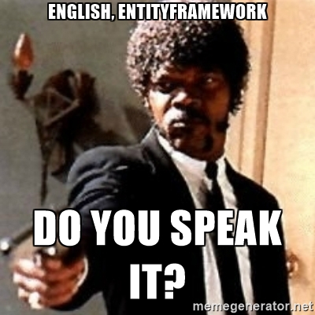
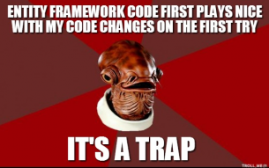
TEAMWORK / ENTITY FRAMEWORK

Slide 6
Main Focus during the project
Add better UI
Use the potential of all EF Relationships
Take some of the game data to the cloud
Implement game/player statistics
Add more functionality
Simplify the code

Slide 7
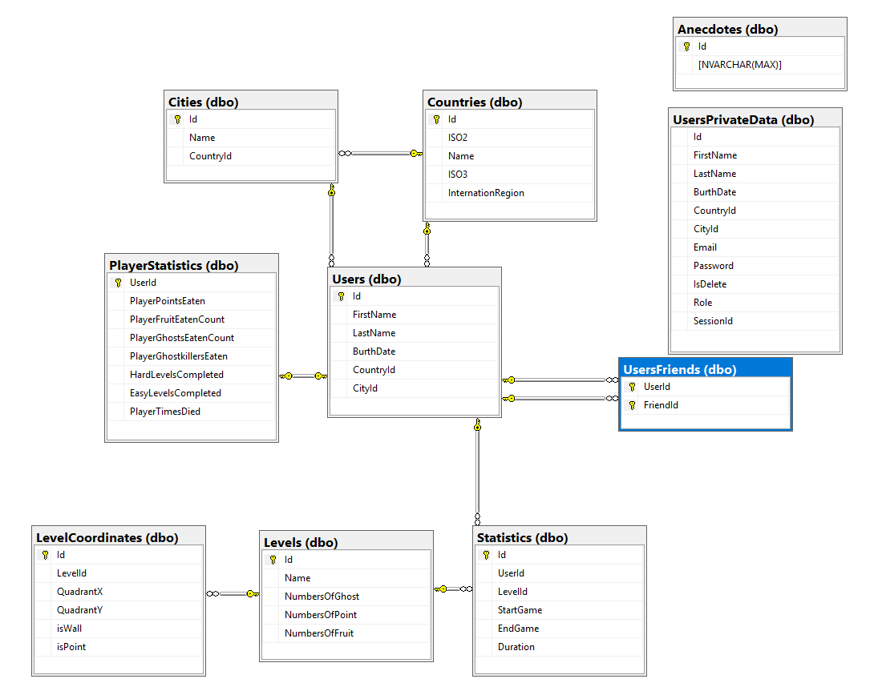

Slide 8
Some of the new functions:
Online database @ Azure.
Level information is now randomly retrieved from the DB.
Login/Register functionality with hashed password, and real-time validation interface.
You can update your profile.
One-To-Many, Many-To-Many, One-To-One Relationships.
Country-City relationship dynamically fills the dropdown list.
Logic for login / update hidden from the code. Only available in the DB.
Added game statistics, such as Total Game Duration, Start Date of the session, etc.
Added player statistics, to keep the progress of each individual user.
Completing a level now lets you automatically jump to the next random level. If you die however, you have to try again ☺
Functionality to Add/Remove friends based on their Id.
Added DataGrid for viewing various statistics In-Game.
Added JsonConverter Class Library for developer import/export of the DB.

Slide 9



